Slide 1

HOME AUTOMATION BY TELEGRAM APP USING RASPBERRY PI
PROJECT TEAM
G . HARSHITHA(19K61A1215)
N. AKANKSHA(19K61A1240)
A. HARIKA(19K61A1201)

Slide 2
ABSTRACT
Automated secure entry is a basic need in today’s Home Automation System. To accomplish this need, we are proposing secure home entry system using Internet of Things. This proposal is an attempt to construct a smart, innovative and secure entry by using the raspberry pi controller, camera and various other associated sensors. To enhance the home security system, the best possible way is to use facial recognition and has been implemented in our proposal. Due to popularity and flexibility of using current social network for all type of generation, we are proposing home security system using Telegram notification.

Slide 3
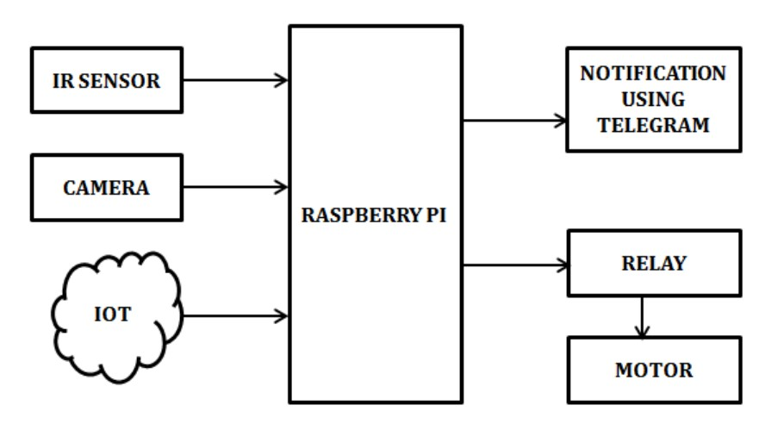
BLOCK DIAGRAM
Raspberry Pi the system is connected with the Internet to get chat messages from the Telegram and the appliances which we have to control should be connected to the GPIO pins of Raspberry Pi through relay circuit.

Slide 4
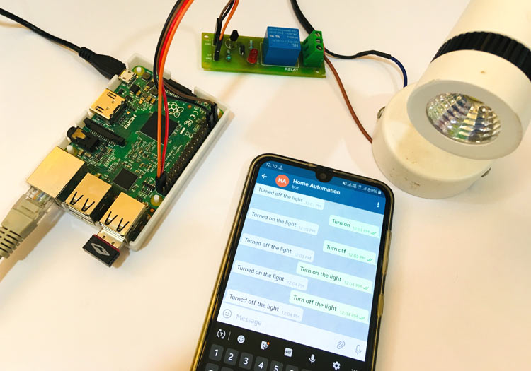
PROJECT DESCRIPTION :
Raspberry Pi which connected to the Network, which is programmed for receiving chats from Telegram app, whenever we send messages to the configured number to switch on the light as chat lights get turned on similarly appliances can be turned off by sending OFF chats. Command chats can be configurable.

Slide 5
HARDWARE AND SOFTWARE REQUIREMENTS
Raspberry Pi | Raspbian OS
IR Sensor | Python
DC Motor | NOOBS
Relay | Adafruit
Power Supply

Slide 6
ADVANTAGES
High security
More efficient
Avoids manpower
Building
Factories
Home

Slide 7

FUTURE SCOPE
Computer vision can be used for motion detection and alerting through telegram.
The system can be used in many fields, for example industrial control and monitoring, automation
Information applications, intelligent systems, and so on. We can implement as a full sensor network.
Further advanced concepts of shocking for unauthorized persons can be adopted to provide ultimate security to the home.

Slide 8

REFERENCES
[1] Jinsoo Han; Chang-Sic Choi; Ilwoo Lee, "More efficient home energy management system based on ZigBee communication. and infrared remote controls," Consumer Electronics, IEEE Transactions on , vol.57, no.1, pp.85,89, February 2011
[2] Erdem, H.; Uner, A., "A multi-channel remote controller for home and office appliances," Consumer Electronics, IEEE Transactions on , vol.55, no.4, pp.2184,2189, November 2009.
[3] Yuksekkaya, B.; Kayalar, A.A.; Tosun, M.B.; Ozcan, M.K.; Alkar, A.Z., "A GSM, internet and speech controlled wireless interactive home automation system," Consumer Electronics, IEEE Transactions on , vol.52, no.3, pp.837,843, Aug. 2006.
[4] Shaik Anwar , D. Kishore “IOT BASED SMART HOME SECURITY SYSTEM WITH ALERT AND DOOR ACCESS CONTROL USING SMART PHONE ” 2016 International Journal of Engineering Research and Technology (IJERT)
[5] G. Changsha, A. J A. Rice, and A. Changzhi Li , “Wireless Smart Sensor Network based on Multi-function Interferometric Radar Sensors for Strut”, IEEE Transaction on structural Health Monitoring, 978-1-4577-1238-8/12 2012
[6] G. Feltrin, O. Saukh, J. Meyerand and M. Motavalli, „structural monitoring with WSN: Experiences from field deployments first middles east conference on smart monitoring, 2011; 8-10. http;//www.mdpi.com/journal/sensors
[7] Chia-Hung Lien; Ying-Wen Bai; Ming-Bo Lin, "Remote-Controllable Power Outlet System for Home Power Management," Consumer Electronics, IEEE Transactions on , vol.53, no.4, pp.1634,1641, Nov. 2007

Slide 9
SMART BAG FOR WOMEN SAFETY

Slide 10
ABSTRACT
With the advancement in wireless technology, many tools have been developed to control a device from a remote location. These eliminate the need of physical availability of a person for controlling the device manually. Generally GSM and GPS technology is used in these tools to locate and control a device. But the tools which use only these technologies for their operation are highly insecure and inefficient. The fingerprint module increases the authenticity of the device and enables multiple users to control the device. These modules are integrated to a simple Arduino microcontroller to demonstrate various functionalities.

Slide 11
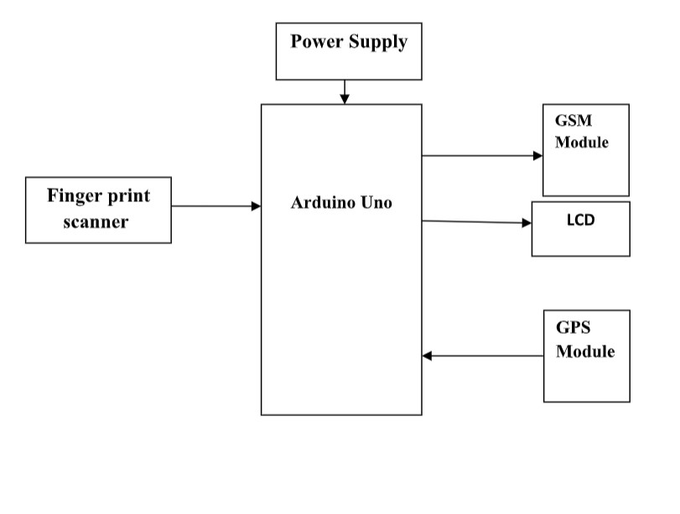
BLOCK DIAGRAM

Slide 12
ADVANTAGES
Safety Device which can be conveyed by everybody.
Ultra low power utilization.
Compact in size with Wireless network.
Easy and quick to install &amp; Easy Maintenance.
Low taken a toll with elite.

Slide 13
HARDWARE REQUIREMENTS
Arduino uno
Fingerprint scanner
LCD
GSM
GPS
Power supply

Slide 14

ANY QUERIES? THANK YOU.

